Slide 1



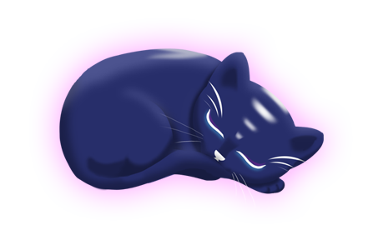
Aurora
Group 6
Charlie Crewe, George Flude, Alex Polley and Callum Walsh.

Slide 2
Our Brief
Create a casual game that uses minimal inputs

Slide 3
Psychograph
Name: Maarii
Age: 48
Occupation: Admin/Sales
Marital Status: Married
Likes:
Sweet pastries
Chocolates
Toffees
Biscuits
Apple Pie
Green Tea
Earl Grey
v
Animals
Cats
Dogs
Horse
Music
Country Rock
80’s Pop
Fears/Dislikes
Insects
Large Dogs
Scaled creatures
Heights

Slide 4

Game Loop
Tap
Reward
Colour

Slide 5
Hooked Model
Trigger
Investment
Action
Variable Reward

Slide 6
Prototype

Slide 7
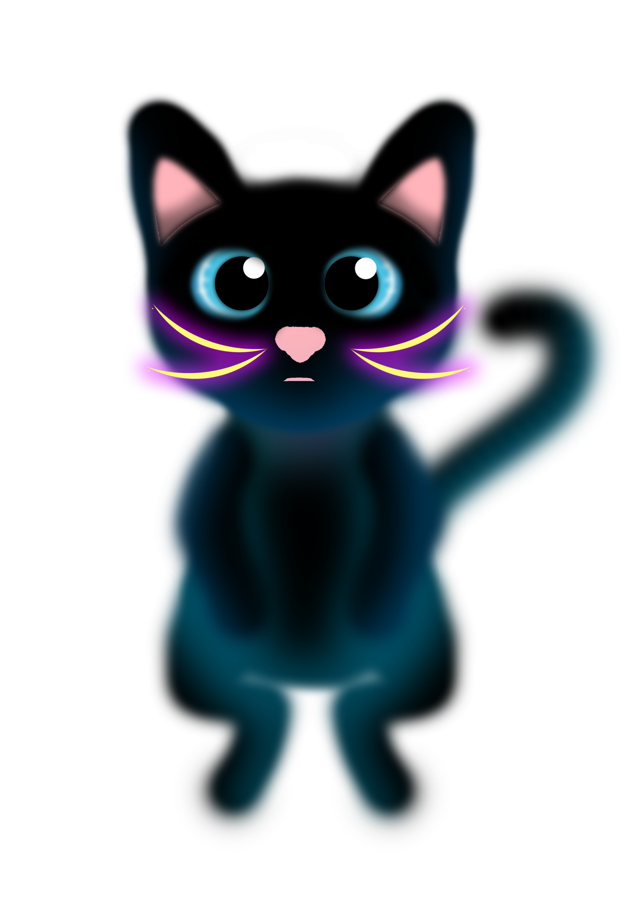
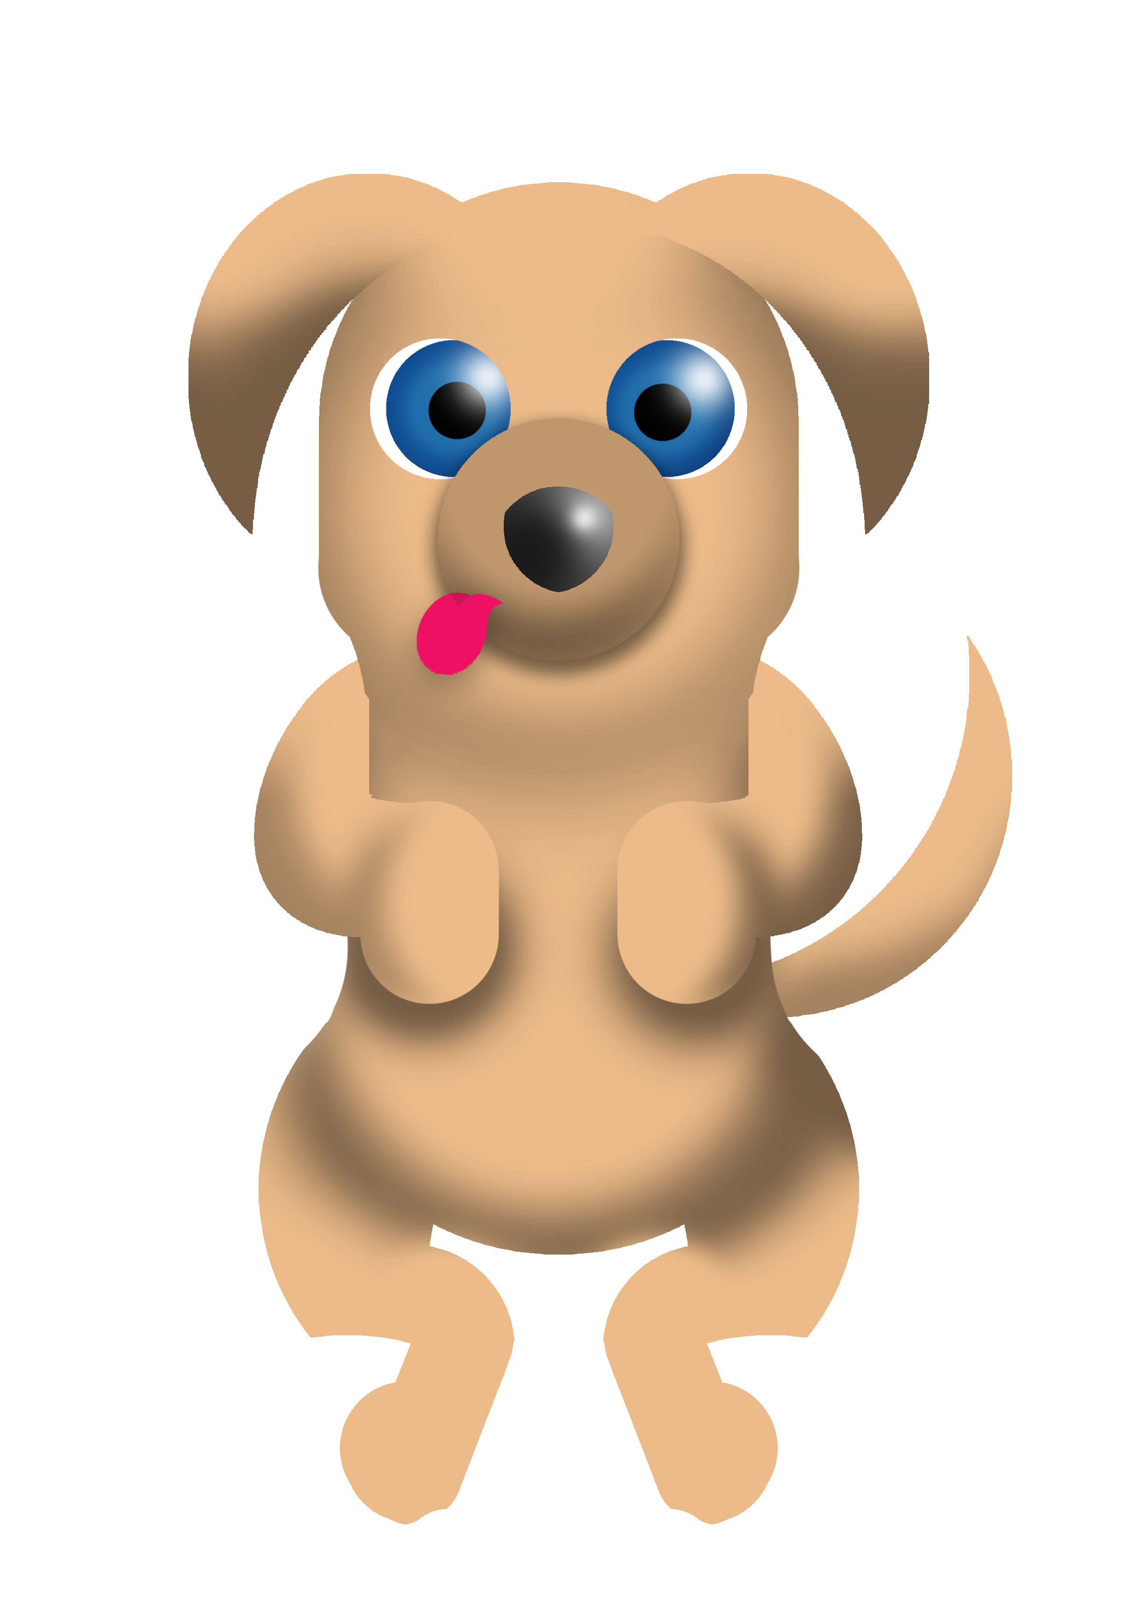
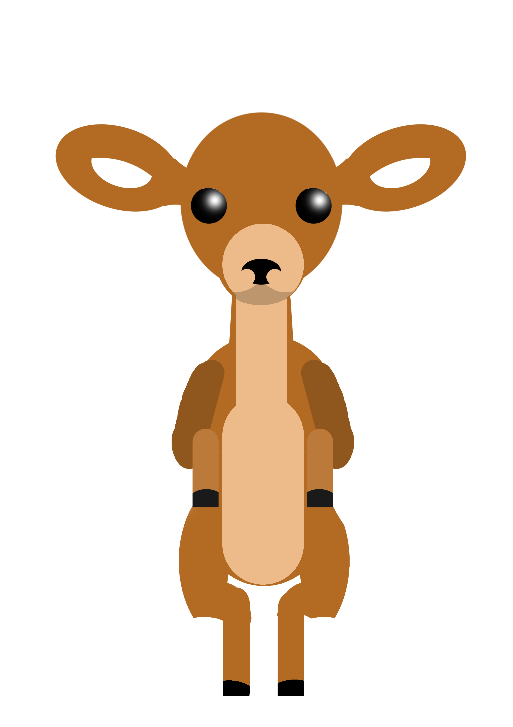
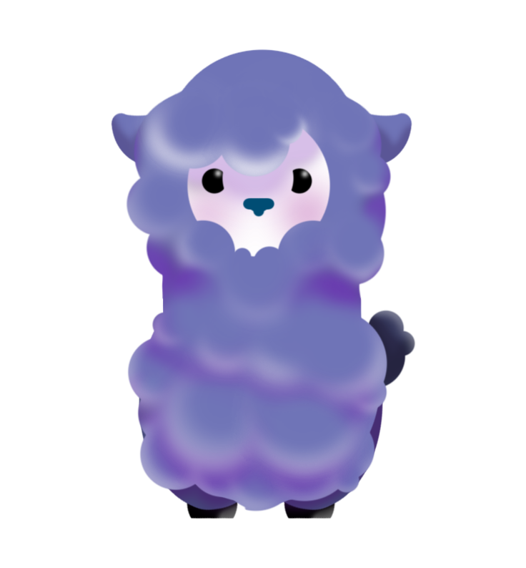

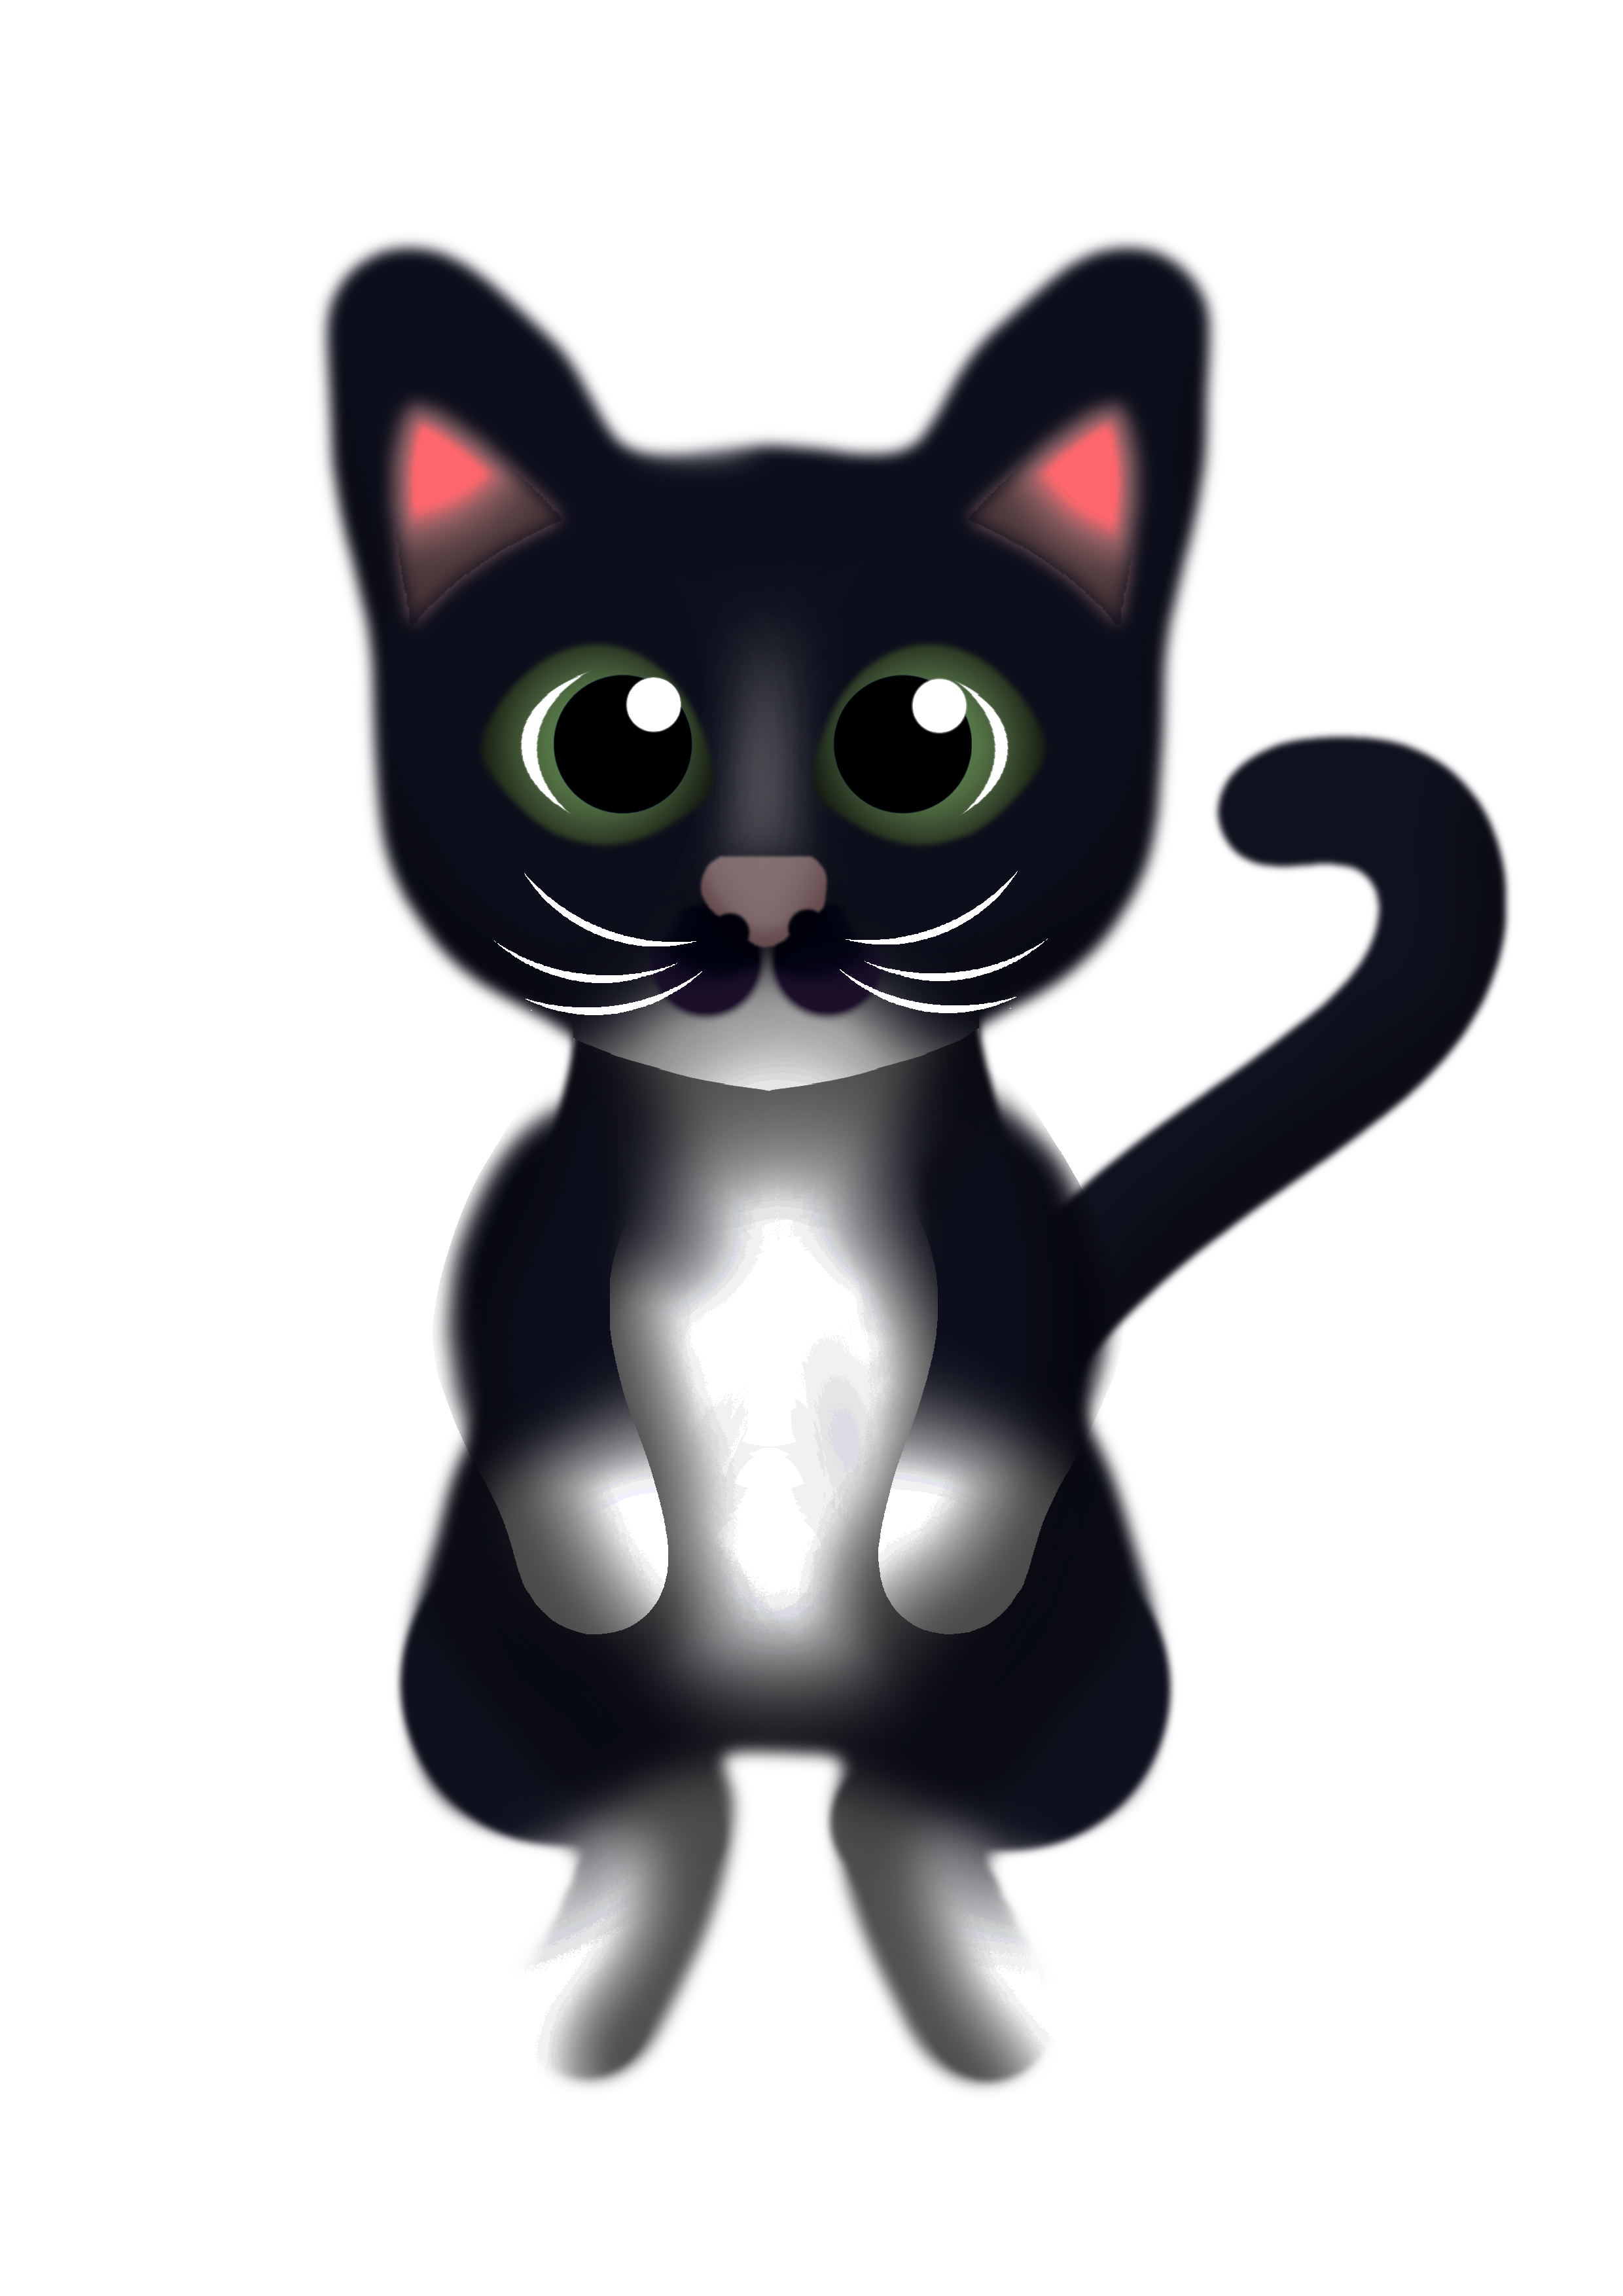
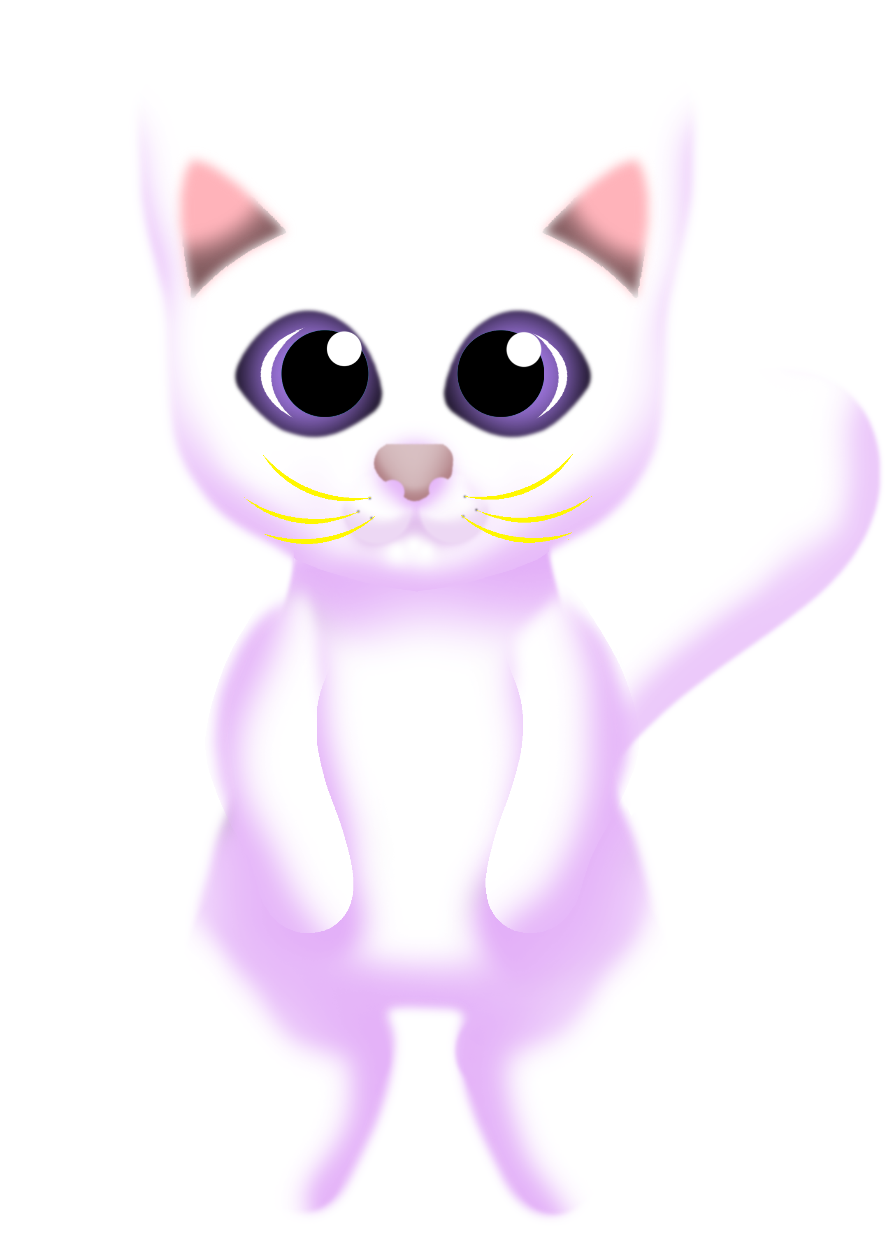
Concepts

Slide 8
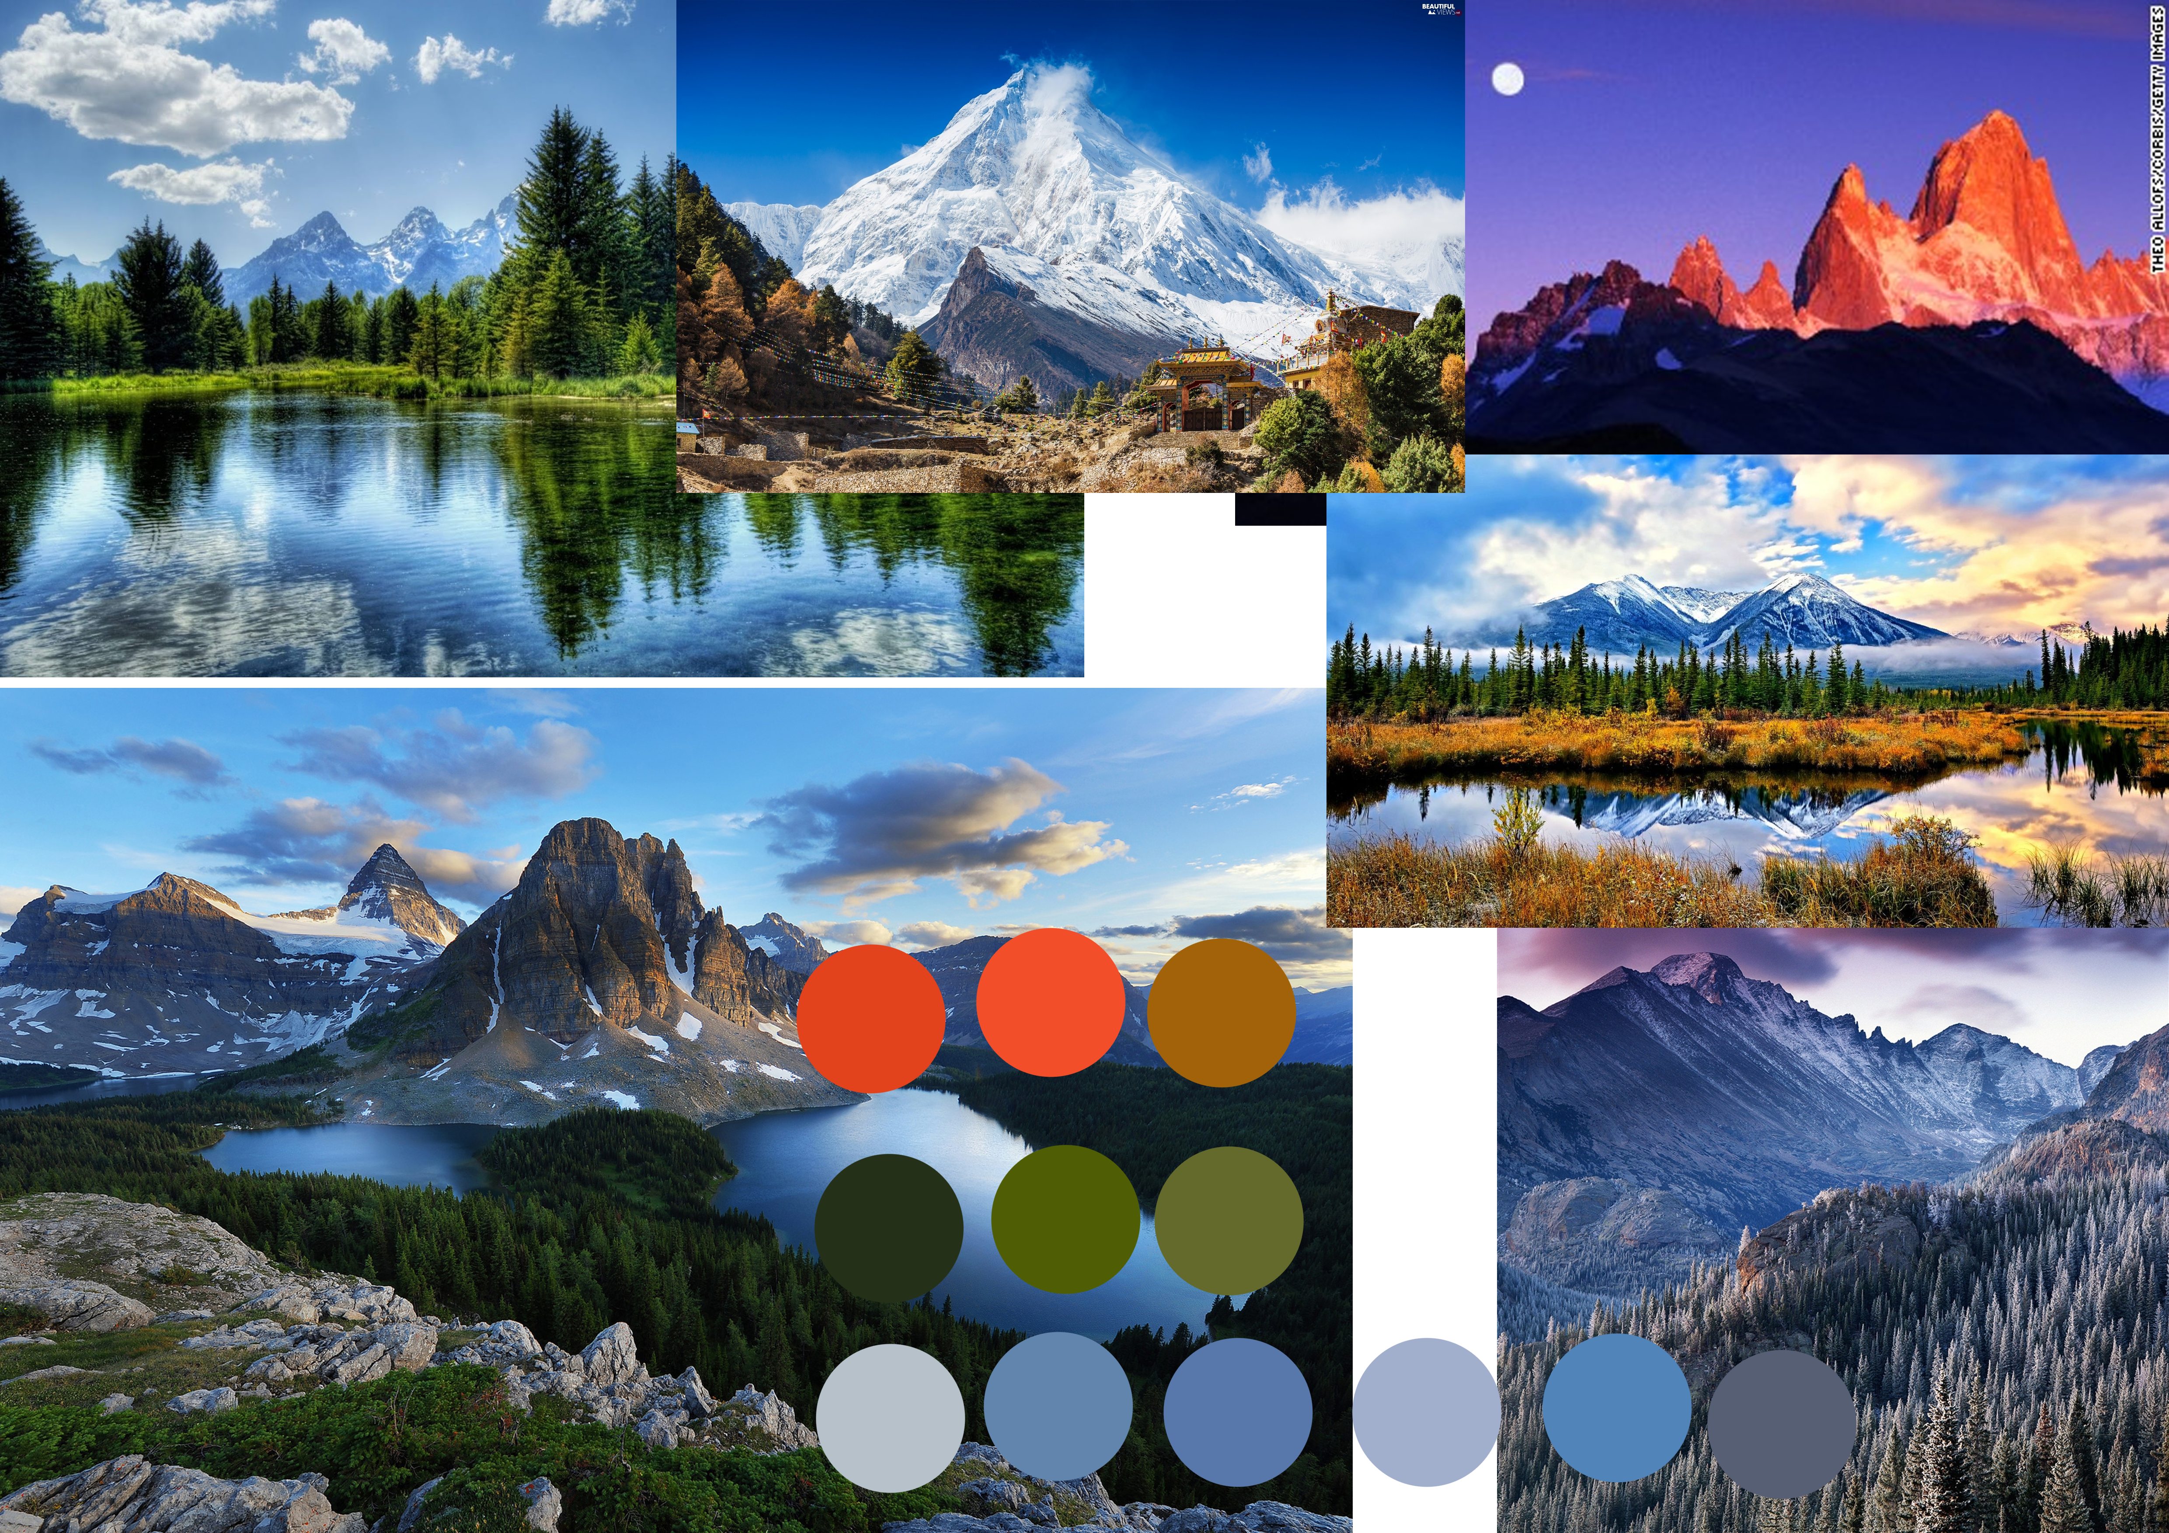

Concepts

Slide 9

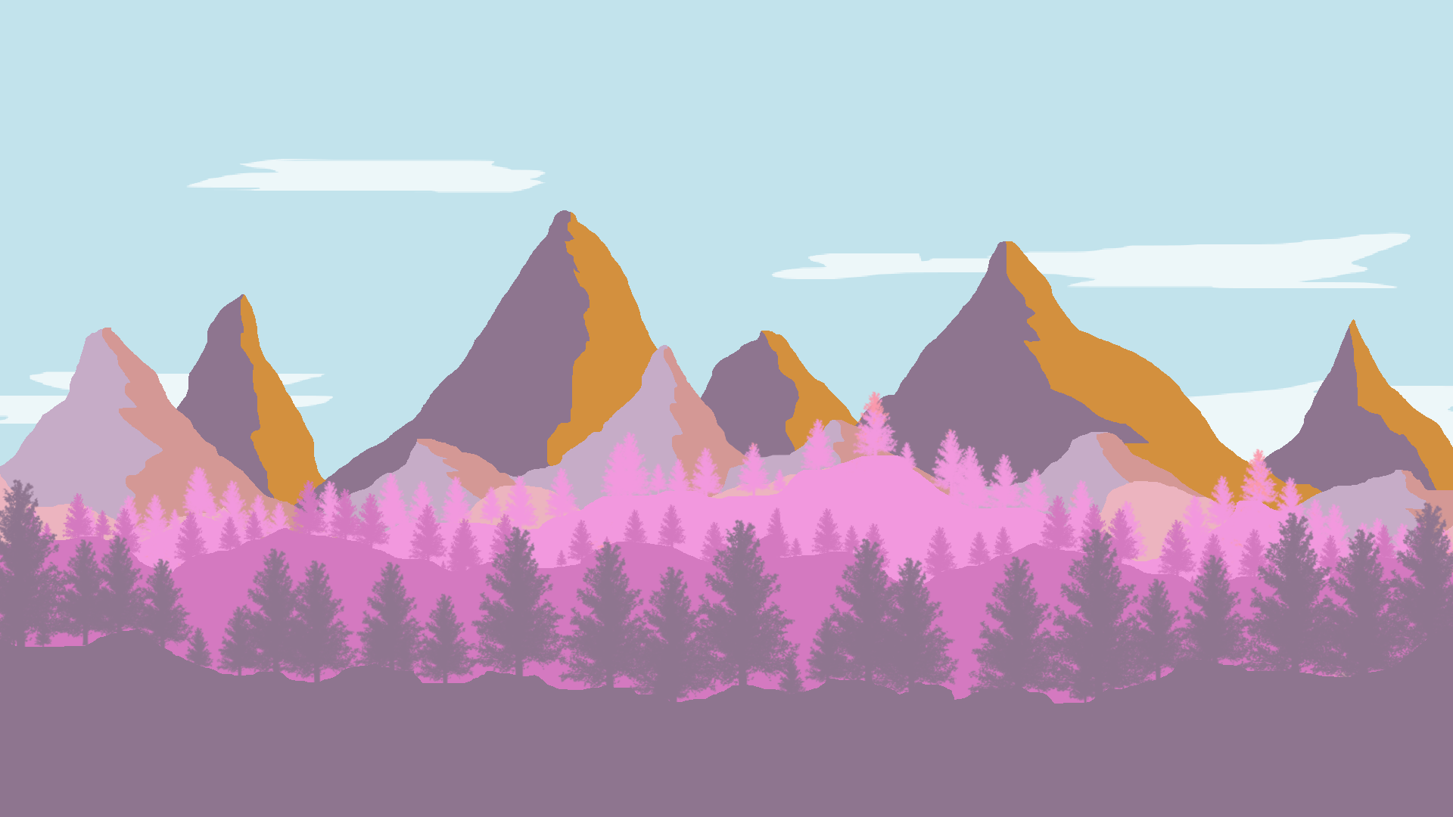
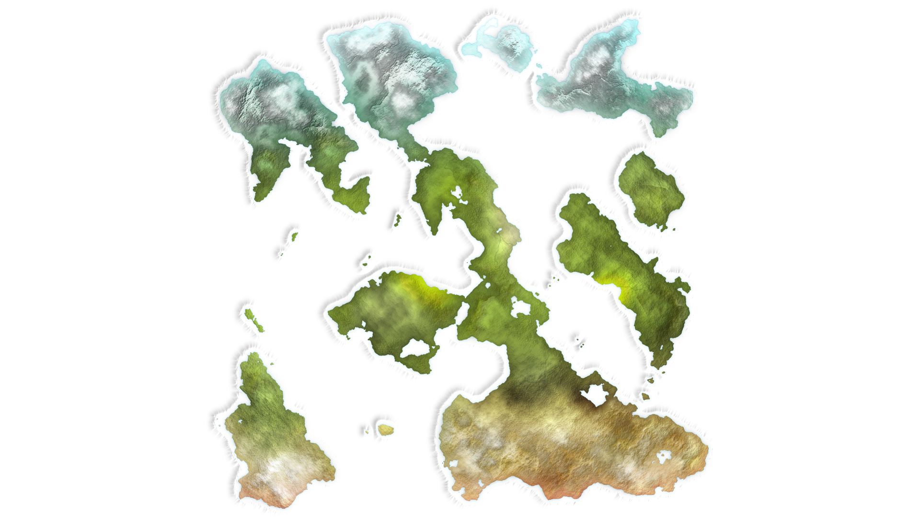

Concepts

Slide 10
Platform
Tablet
Screen size suitable for psychographic
Mobile Devices
Provides the means to play on-the-go

Slide 11
Usability Testing
Paint Strokes felt too repetitive
(Needs playtesting feedback)

Slide 12
Playtest
(Video)

Slide 13
Strengths and Weaknesses
Strengths
Weaknesses

Slide 14
What needs to be done
Modular construction of scenery
Customisation
Refinement of colour loop
Playtest

